Slide 1
Unsupervised Discovery of
Mid-Level Discriminative Patches
Research Project Master AI
Group 4
Salil Bhat, Ioannis Papadopoulos,
Stefan Selzer, Chang Sun

Slide 2
Outline
Motivation
Definition
Approach
Project Plan
Group 4 - Unsupervised Discovery of Mid-Level Discriminative Patches

Slide 3
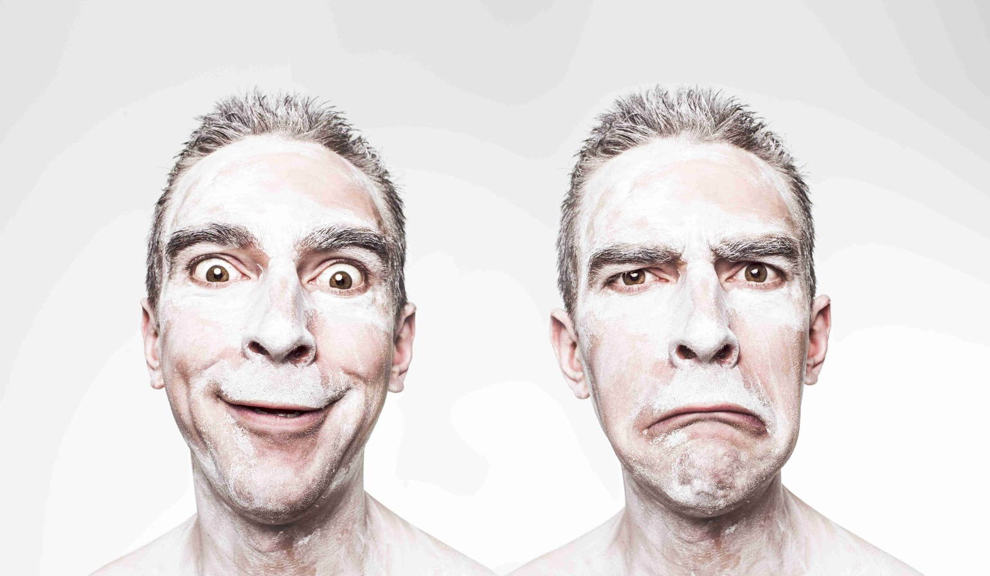
Objective
Classification of facial expressions
Group 4 - Unsupervised Discovery of Mid-Level Discriminative Patches

Slide 4
Deliverables
Extensible code
  C++
  OpenCV
Documentation
Group 4 - Unsupervised Discovery of Mid-Level Discriminative Patches

Slide 5
Mid-Level Discriminative Patch
Part of an image describing one feature
Representative
Different
Detectable with high precision
Group 4 - Unsupervised Discovery of Mid-Level Discriminative Patches

Slide 6
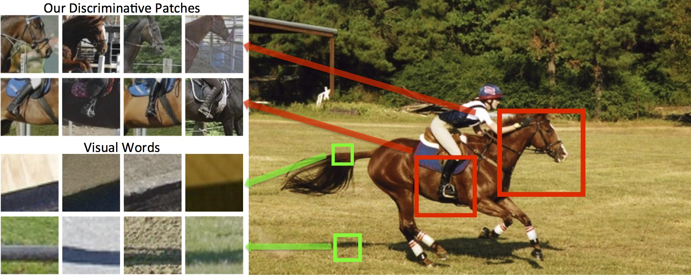
Example
Group 4 - Unsupervised Discovery of Mid-Level Discriminative Patches

Slide 7
Approach – clustering
Standard approach: Unsupervised clustering (K-means)
Unsupervised K-means restricted to low level distance metric – patches are medium sized
Group 4 - Unsupervised Discovery of Mid-Level Discriminative Patches

Slide 8
Approach – classifying
Given similar patches easy to train a discriminative classifier (SVM)
Clustering requires a good similarity measure, similarity requires good clusters
Group 4 - Unsupervised Discovery of Mid-Level Discriminative Patches

Slide 9
Algorithm (1)
Initialize some arbitrary clusters using K-means
Iterative step:
  Train a 1 vs all linear SVM classifier for each cluster
  Assign new clusters according to the svm similarity measure
Group 4 - Unsupervised Discovery of Mid-Level Discriminative Patches

Slide 10
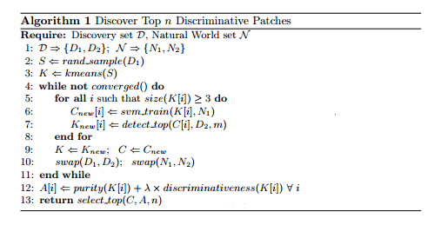
Algorithm (2)
Group 4 - Unsupervised Discovery of Mid-Level Discriminative Patches

Slide 11

Patch Ranking
Group 4 - Unsupervised Discovery of Mid-Level Discriminative Patches

Slide 12
Progress so far
Familiarize with project background
Check implementation details
  Feature extractor using Histogram of Oriented Gradients
  Clusterer using k-means
  Classifier using Support Vector Machine
Find appropriate datasets
Group 4 - Unsupervised Discovery of Mid-Level Discriminative Patches

Slide 13
About Dataset
Task: Find/Create/Annotate the proper dataset
Requirements:
  Focus on facial features
  Uniform size, pixel, lighting and angle.
  Different expressions of one person.
Group 4 - Unsupervised Discovery of Mid-Level Discriminative Patches

Slide 14
About Dataset
Based on CK+ Dataset
561 images of 123 adults (B&W, Color)
Images have Uniform Standard
Neutral faces & seven facial expressions
Group 4 - Unsupervised Discovery of Mid-Level Discriminative Patches

Slide 15
Emotion Label
Neutral + Seven Emotions :
0 Neutral 1 Anger
2 Contempt 3 Disgust
4 Fear 5 Happy
6 Sadness 7 Surprise
Group 4 - Unsupervised Discovery of Mid-Level Discriminative Patches

Slide 16
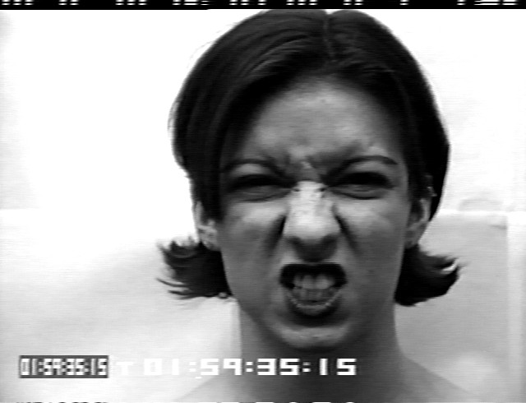
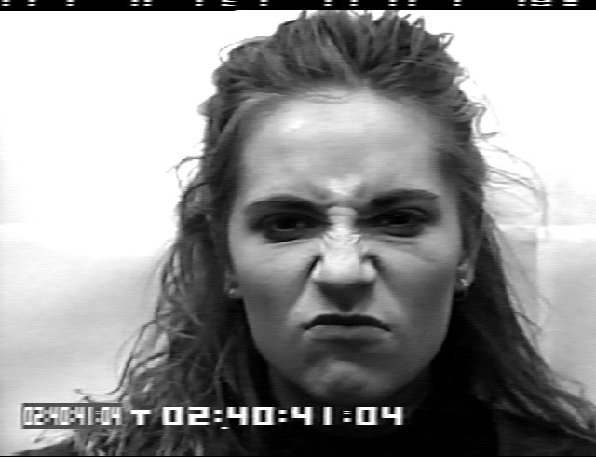
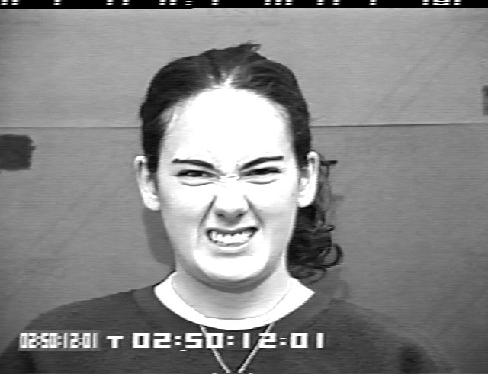
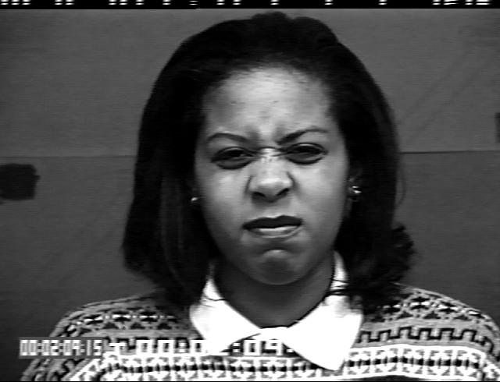
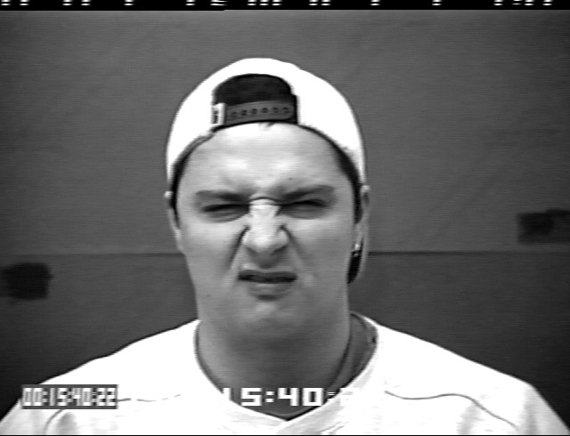
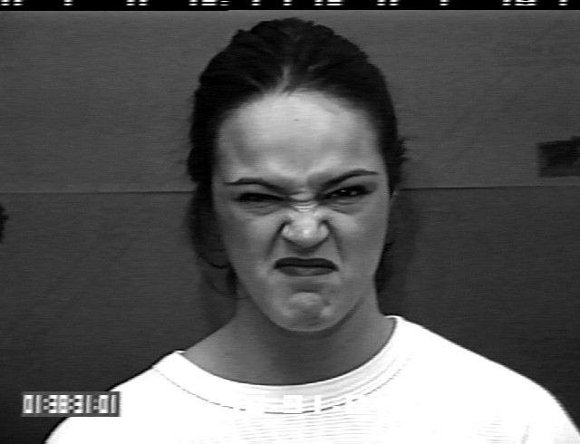

Slide 17
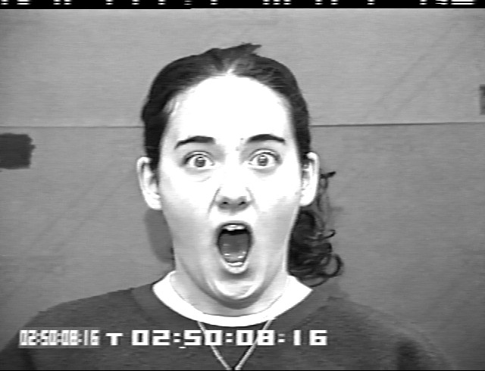
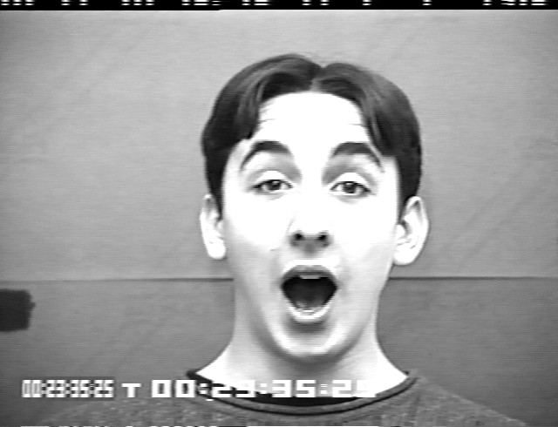
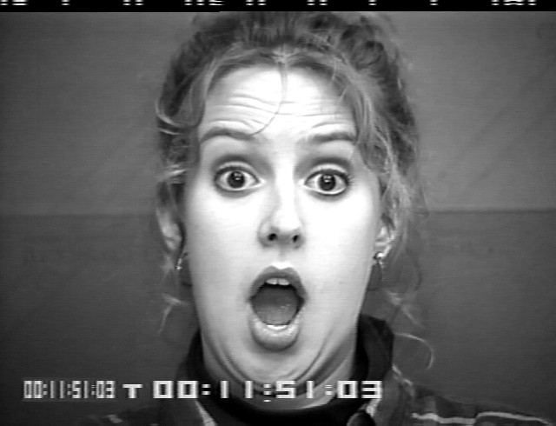
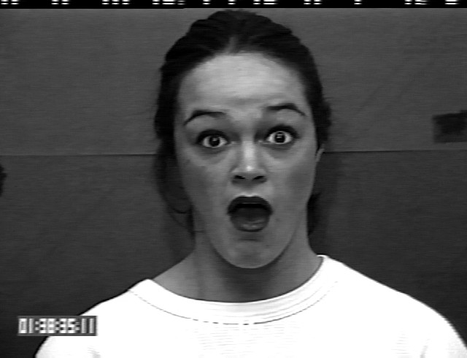
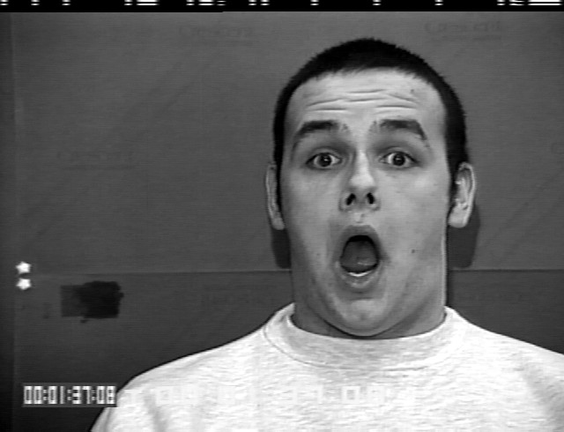
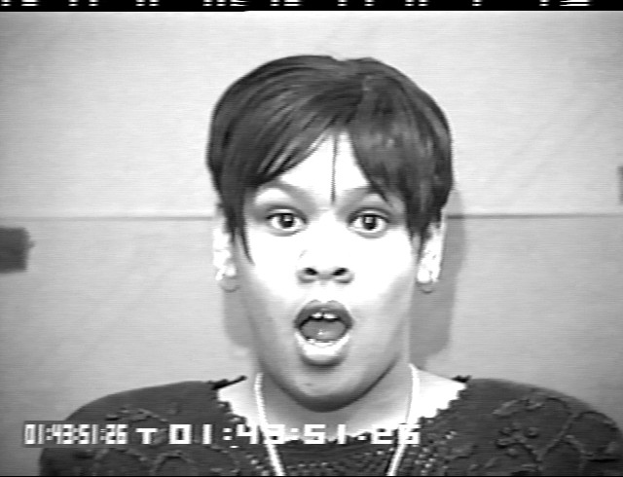

Slide 18
AU | Facial Description | AU | Facial Description
1 | Inner Brow Raiser | 24 | Lip Pressor
2 | Outer Brow Raiser | 25 | Lips Part
4 | Brow Lower | 26 | Jaw Drop
5 | Upper Lip Raiser | 27 | Mouth Stretch
6 | . . . | 28 | . . .
7 | . . . | 29 | . . .
Find major facial features of each emotion
Rules: Surprise = 1+2+5B+26/27 (Intensity: A<B<C<D<E)
Fear = 1+2+4+5+20+25
. . . . .
Group 4 - Unsupervised Discovery of Mid-Level Discriminative Patches

Slide 19
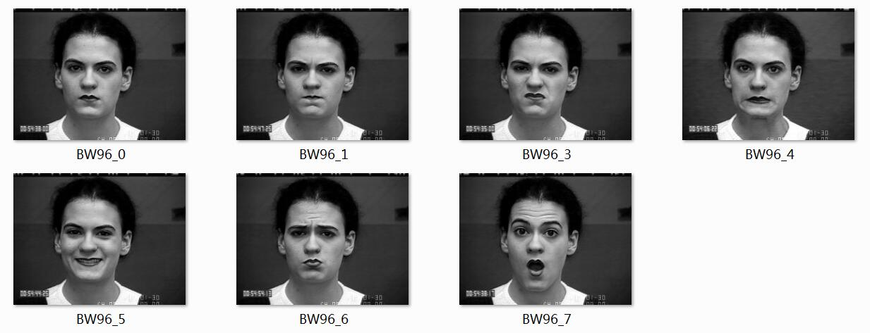
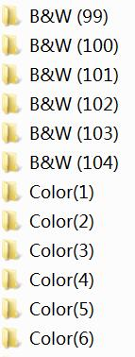
Classified by Persons
Group 4 - Unsupervised Discovery of Mid-Level Discriminative Patches

Slide 20
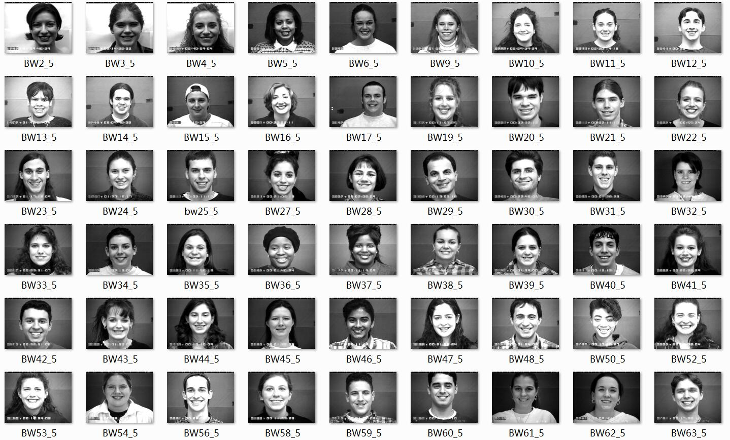
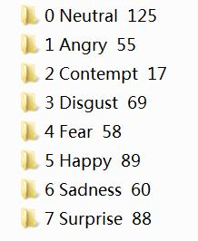
Classified by Emotions
Group 4 - Unsupervised Discovery of Mid-Level Discriminative Patches

Slide 21
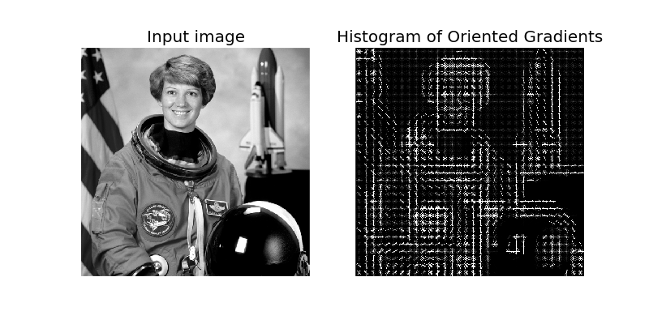
Histogram of oriented gradients (HOG)
Group 4 - Unsupervised Discovery of Mid-Level Discriminative Patches

Slide 22
Histogram of Oriented Gradients
First described in 2005 by Navneet Dalal and Bill Triggs for human detection in videos.
The technique counts occurrences of gradient orientation in localized portions of an image.
The HOG is invariant to local geometric and photometric transformations.
Group 4 - Unsupervised Discovery of Mid-Level Discriminative Patches

Slide 23
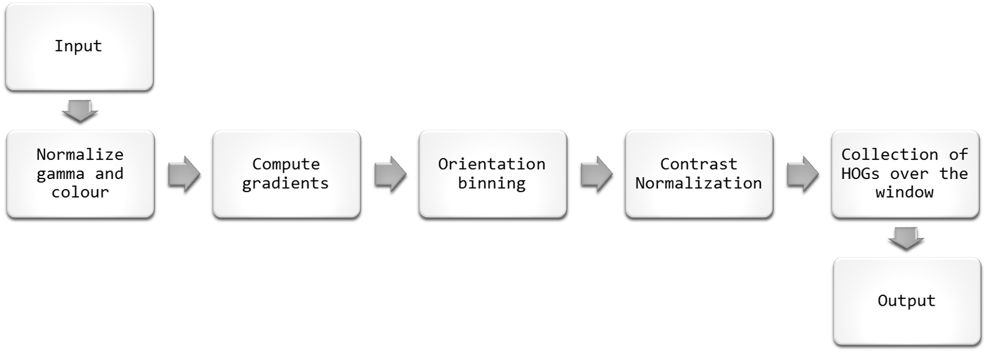
Histogram of Oriented Gradients
Group 4 - Unsupervised Discovery of Mid-Level Discriminative Patches

Slide 24
Histogram of Oriented Gradients
Step 1 : Normalization of gamma and colour or scaling of intensities.
Step 2 : Gradient is computed by using 1d derivative masks
Mask for X direction : [-1 0 1]
Mask for Y direction : [-1 0 1]^{T}
Group 4 - Unsupervised Discovery of Mid-Level Discriminative Patches

Slide 25
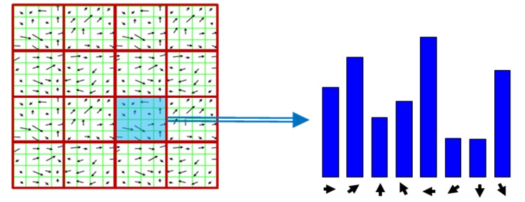
Histogram of Oriented Gradients
Step 3 : Each pixel calculates a weighted vote for an gradient centered on it, and the votes are accumulated into orientation bins.
Group 4 - Unsupervised Discovery of Mid-Level Discriminative Patches

Slide 26
Histogram of Oriented Gradients
Step 4: The histogram is normalized such that weights of the vote are scaled to acceptable values.
Step 5: The detection window is scanned over whole image.
Group 4 - Unsupervised Discovery of Mid-Level Discriminative Patches

Slide 27

K-means Clustering
Group 4 - Unsupervised Discovery of Mid-Level Discriminative Patches

Slide 28
Clustering – project usage
Performed on HOG space
Experiment with different distance metrics
Large number of clusters to maintain high purity
Group 4 - Unsupervised Discovery of Mid-Level Discriminative Patches

Slide 29
Linear Support Vector Machine
Non-probabilistic binary linear classifier
Hyperplane with maximized distance to nearest data point on each side
Linearly separable problem space
Support vectors: points on margin
Supervised learning model
Group 4 - Unsupervised Discovery of Mid-Level Discriminative Patches

Slide 30
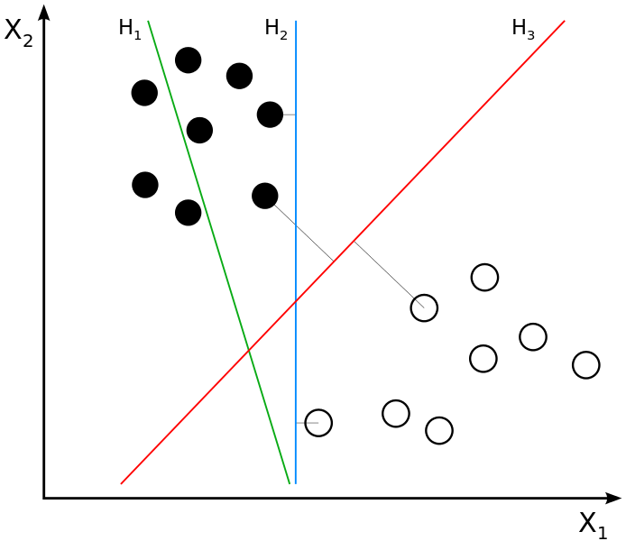
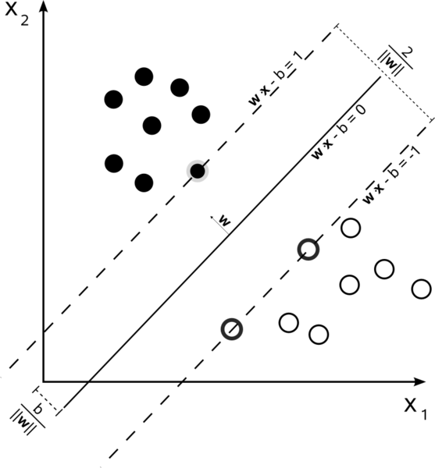
Linear Support Vector Machine Example
Group 4 - Unsupervised Discovery of Mid-Level Discriminative Patches

Slide 31
SVM - Project Usecase
One classifier for each detected patchcluster
Trained positive for one category of facial expressions
Best classifiers according to purity and discriminativness chosen
Rest discarded
Group 4 - Unsupervised Discovery of Mid-Level Discriminative Patches

Slide 32
Support Vector Machine OpenCV
Training input:
  Matrix for training data
    Rows ~ images
  Matrix for labels
    Rows ~ positive or negative
Testing output:
  label / distance
  Support vectors
Group 4 - Unsupervised Discovery of Mid-Level Discriminative Patches

Slide 33


OpenCV Prototype
Unit tests with simple images
Group 4 - Unsupervised Discovery of Mid-Level Discriminative Patches

Slide 34
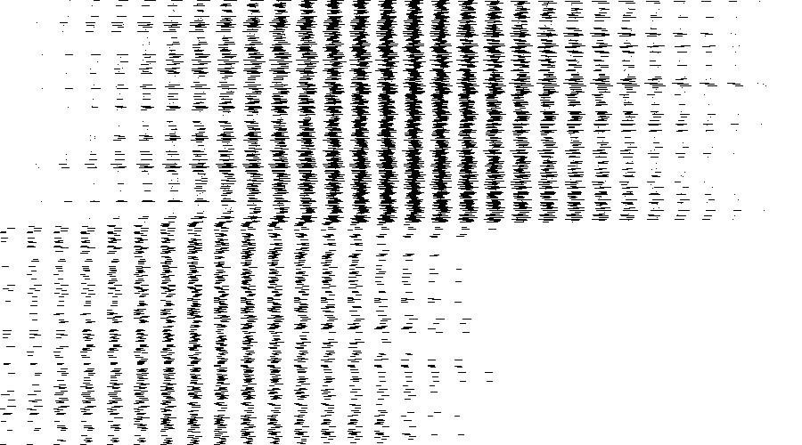
OpenCV Prototype
Setup works
Poor results
Group 4 - Unsupervised Discovery of Mid-Level Discriminative Patches

Slide 35
Project Setup
CMake build configuration for platform independent development
Doxygen configuration for in code documentation
Group 4 - Unsupervised Discovery of Mid-Level Discriminative Patches

Slide 36
Next Steps (1)
Implement
  Prototypes as modules
  Datastructures
  IO (visual debugging)
  Combine modules to overall algorithm
  Supplementary methods
Group 4 - Unsupervised Discovery of Mid-Level Discriminative Patches

Slide 37
Next Steps (2)
Organize the datasets
  Categorization
  Positives / negatives
  Training / validation
Group 4 - Unsupervised Discovery of Mid-Level Discriminative Patches

Slide 38
References
Singh et al., ”Unsupervised discovery of mid-level discriminative patches.”, Computer Vision-ECCV 2012: pp 73-86. (2012)
Doersch et al. „What makes Paris look like Paris?.“ , ACM Transactions on Graphics 31, no. 4 (2012)
Group 4 - Unsupervised Discovery of Mid-Level Discriminative Patches

Slide 39
Questions ?
Group 4 - Unsupervised Discovery of Mid-Level Discriminative Patches

Slide 40
Thank you for your attention!
Salil Bhat
Giannis Papadopoulos
Chang Sun
Stefan Selzer
s.selzer@student.maastrichtuniversity.nl
Group 4 - Unsupervised Discovery of Mid-Level Discriminative Patches

